Slide 1
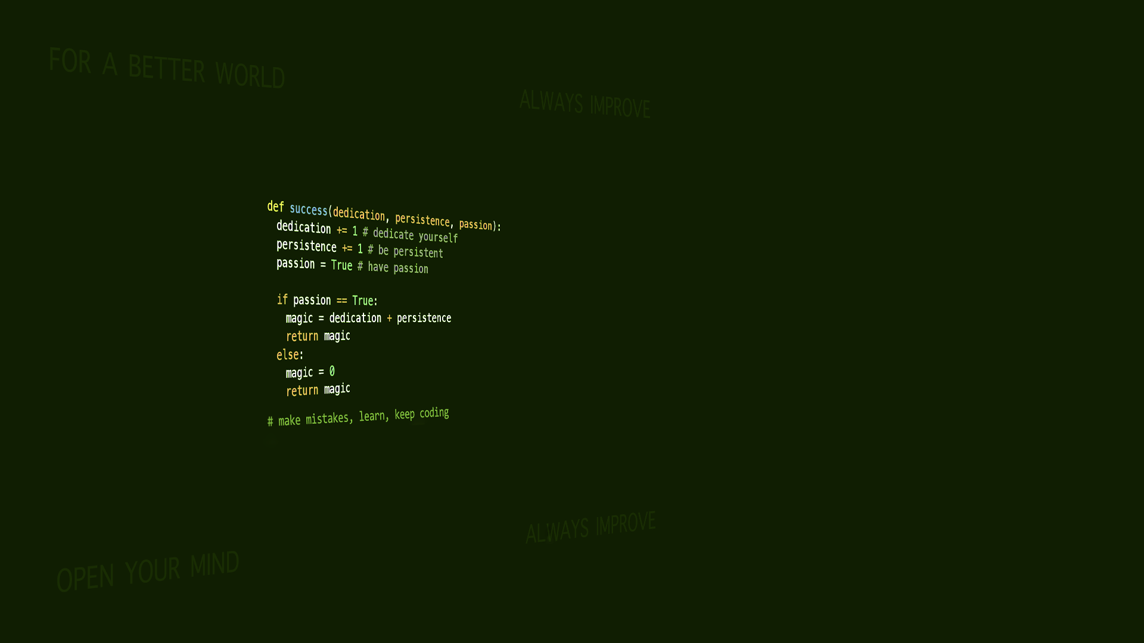
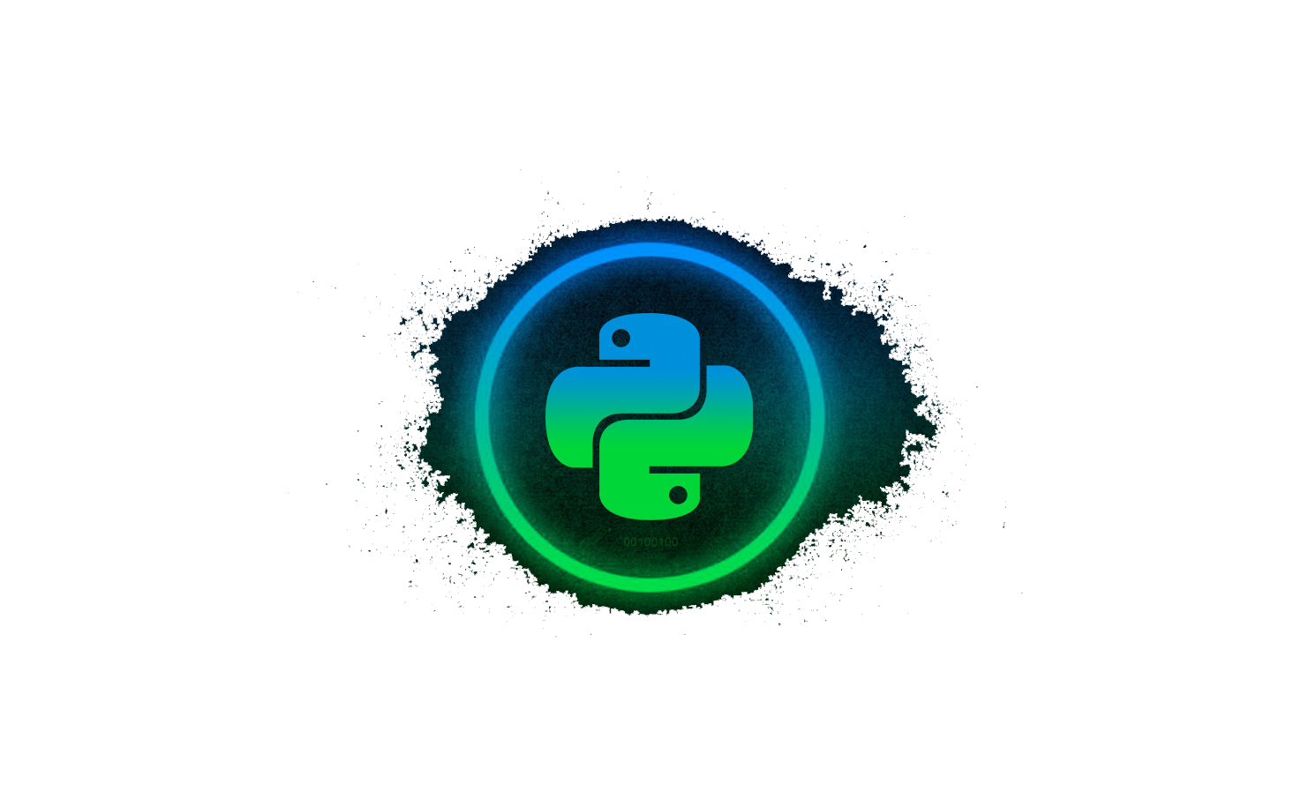
Introduction to Programming in Python
Universal Design of ICT
Abhijeet Sapkota

Slide 2

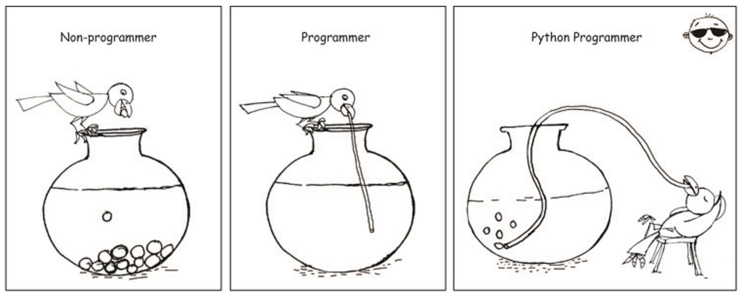
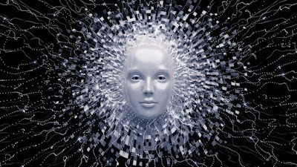
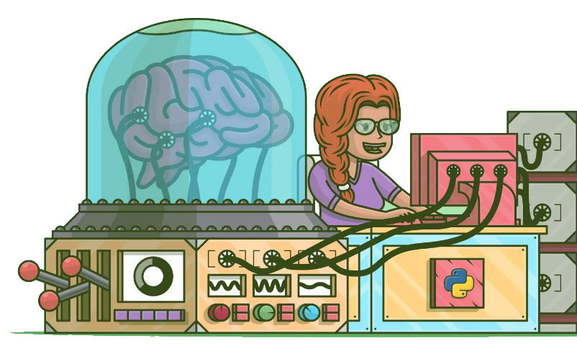
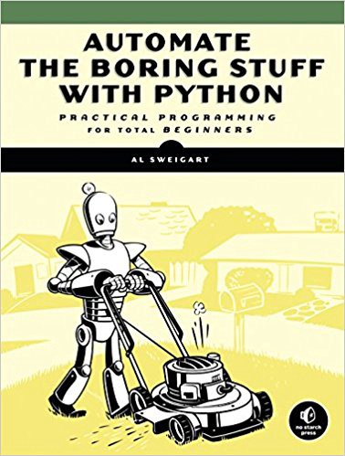

Why python?
Perfect to begin programming
Artificial Intelligence
Machine Learning
Large Community

Slide 3
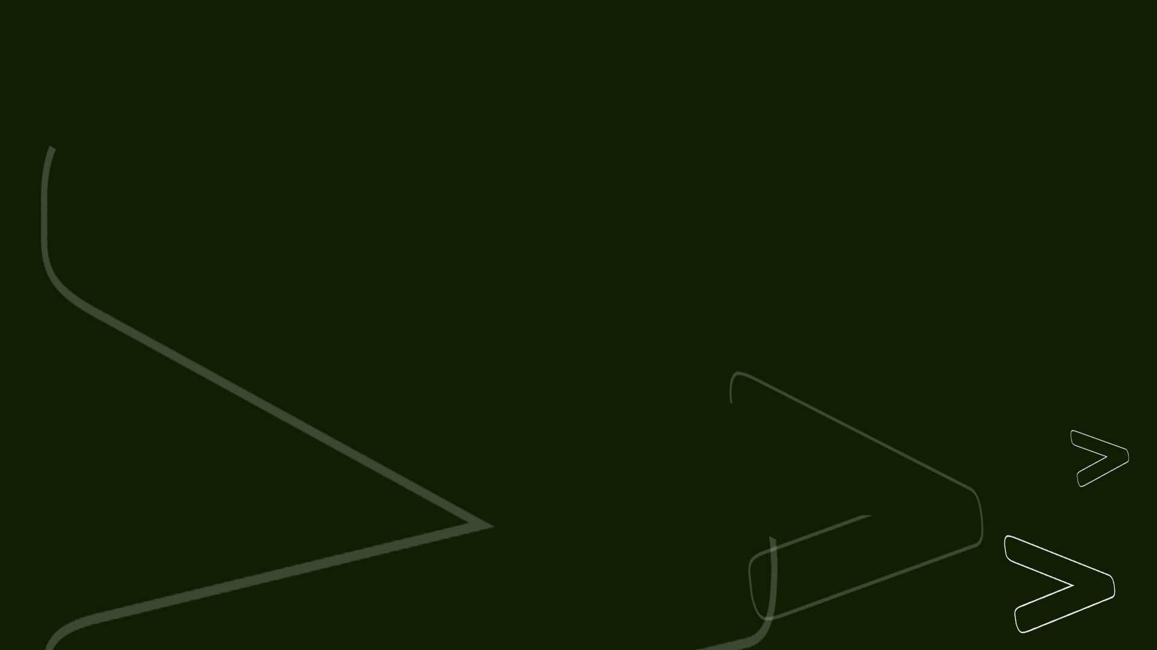
Overview
Preparing PyCharm (15 minutes)
Python Syntax (Data and Expressions)
Control Structures and Conditions
Functions
File Handling
Notes:
Python Syntax (Data and Expressions)
Control Structures and Conditions
Functions
File handling

Slide 4
Python Syntax (Data and expressions)
Comment
First Program
Variables
Data Types
Arithmetic Operations
Converting data types
Indentation

Slide 5
Control Structures and Conditions
Syntax
Sequential control flow
Selection control flow
Iterative control flow

Slide 6
Functions
Syntax
Defining functions
Types of functions
1. Non- value returning
2. Value returning
Calling function
Arguments and Parameters

Slide 7
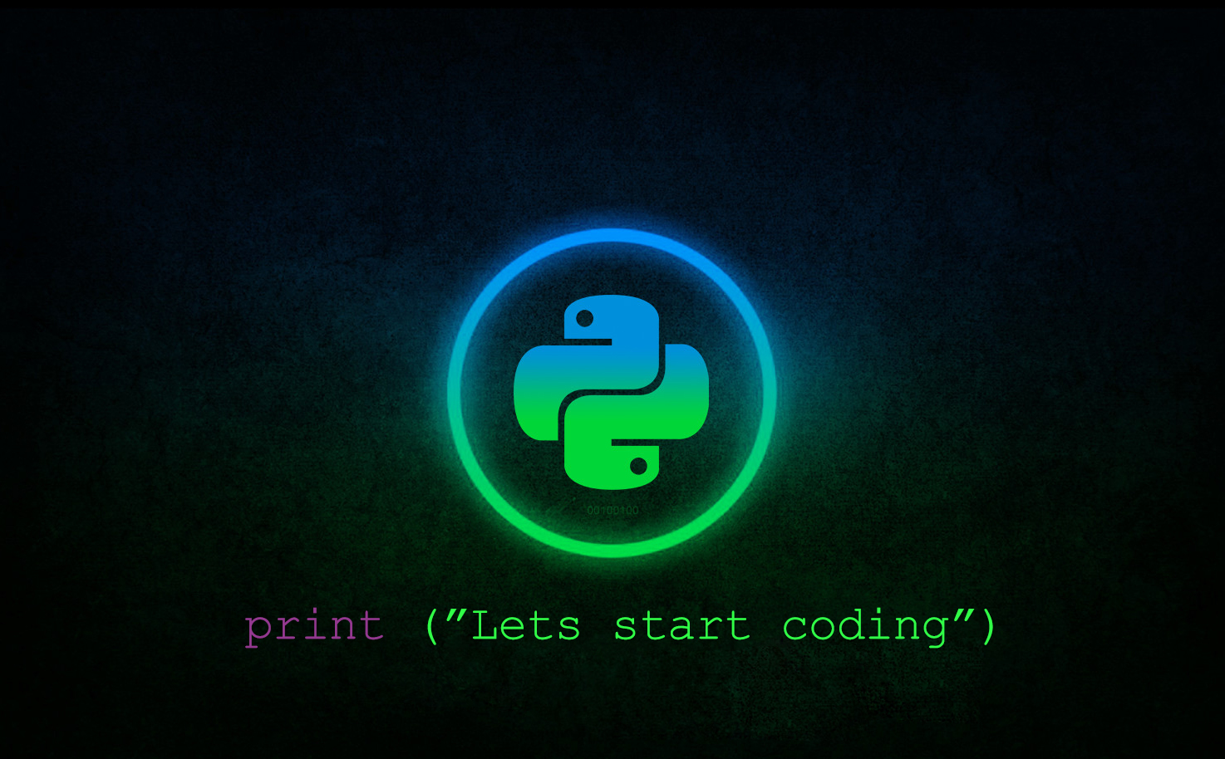

Slide 8
